Slide 1



Molecular Structure of Deuterated 2-aminopyridine
Jack Nichols
Mentors: Dr. Stephen Kukolich and Dr. Adam Daly
Arizona NASA Space Grant Symposium – Tempe, Arizona
04/22/23

Slide 2
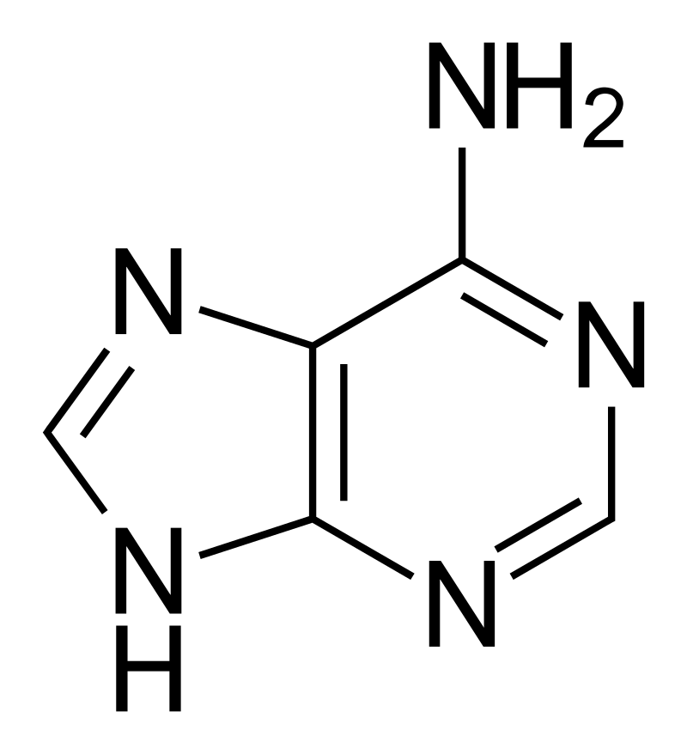
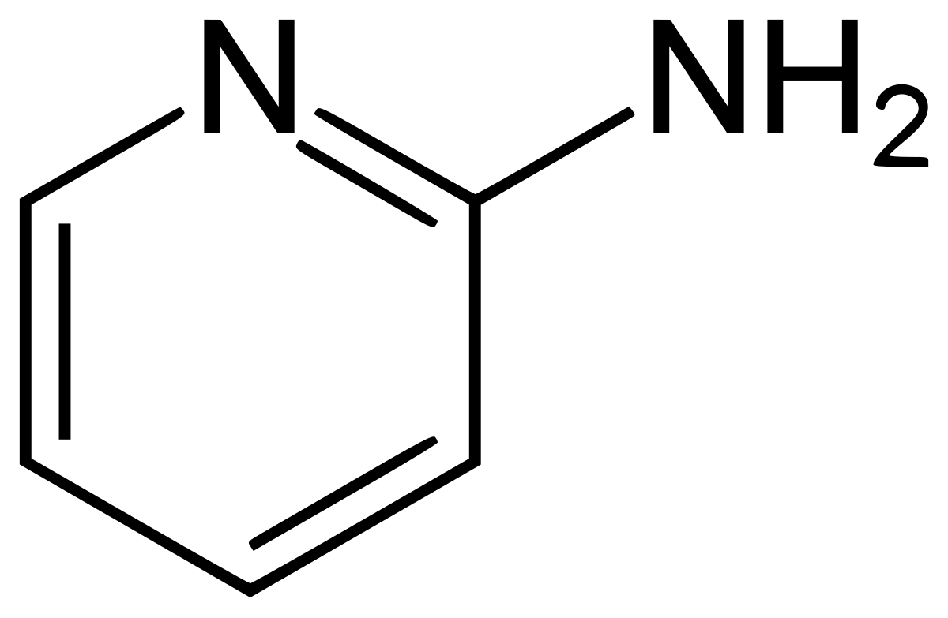
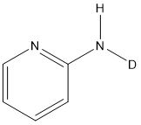
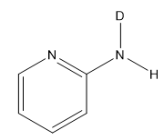
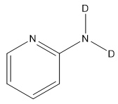
Introduction
Determine the rotational structure of deuterated isotopologues of 2-aminopyridine using microwave spectroscopy
Similar structure to nucleic acid bases like adenine
Useful in future work with complexes of 2-aminopyridine
Adenine
2-aminopyridine
Source: Wikipedia
Deuterated Isotopologues of 2-aminopyridine

Slide 3
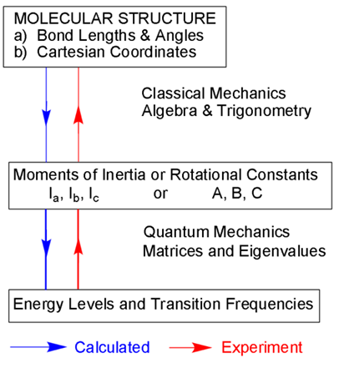
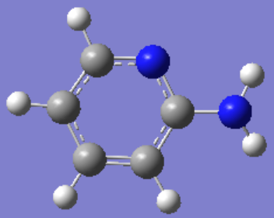
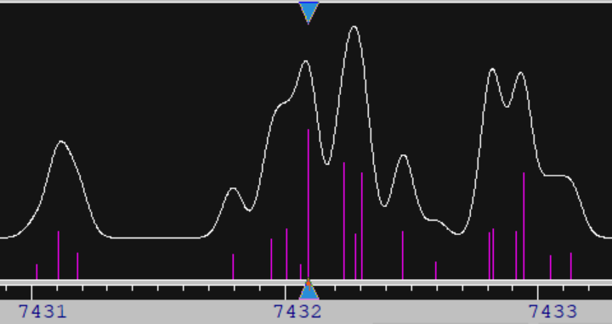
*Image produced using GaussView
*Image produced using Dr. Kiesiel’s ASCP_L program
Source: Kukolich Group

Slide 4
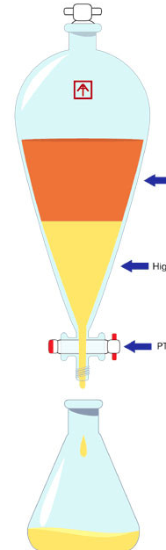
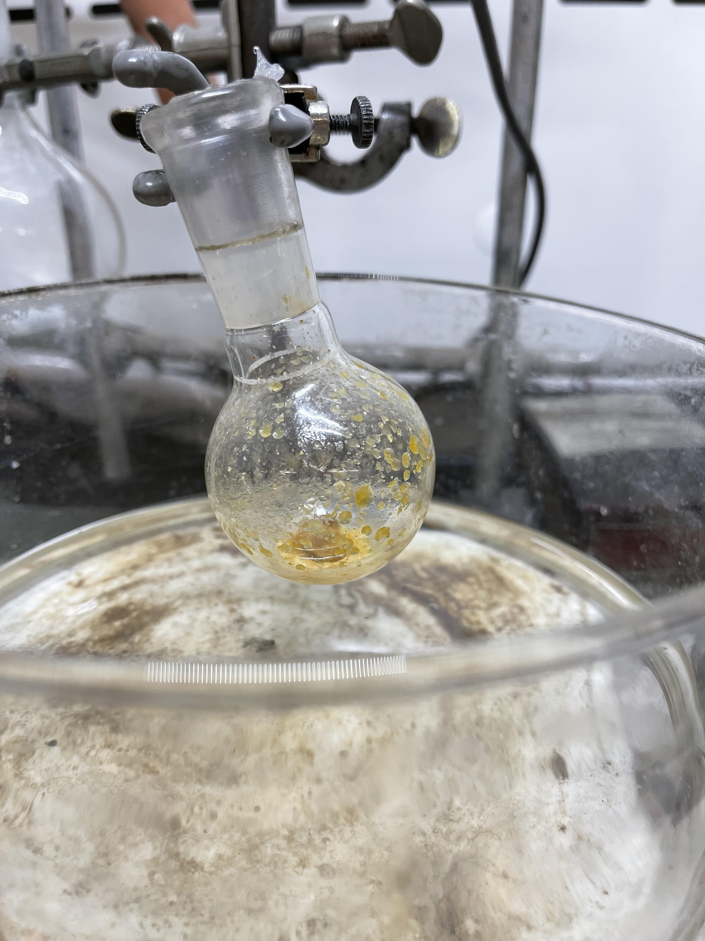

Synthesis of Isotopologues
Extract with Chloroform
Dissolve in
*Image obtained from Hydrobuilder.com
Repeated this process 3 times
R.A. Kydd, I.M. Mills, J. Mol. Spectrosc. 42 (1972) 320–326.

Slide 5
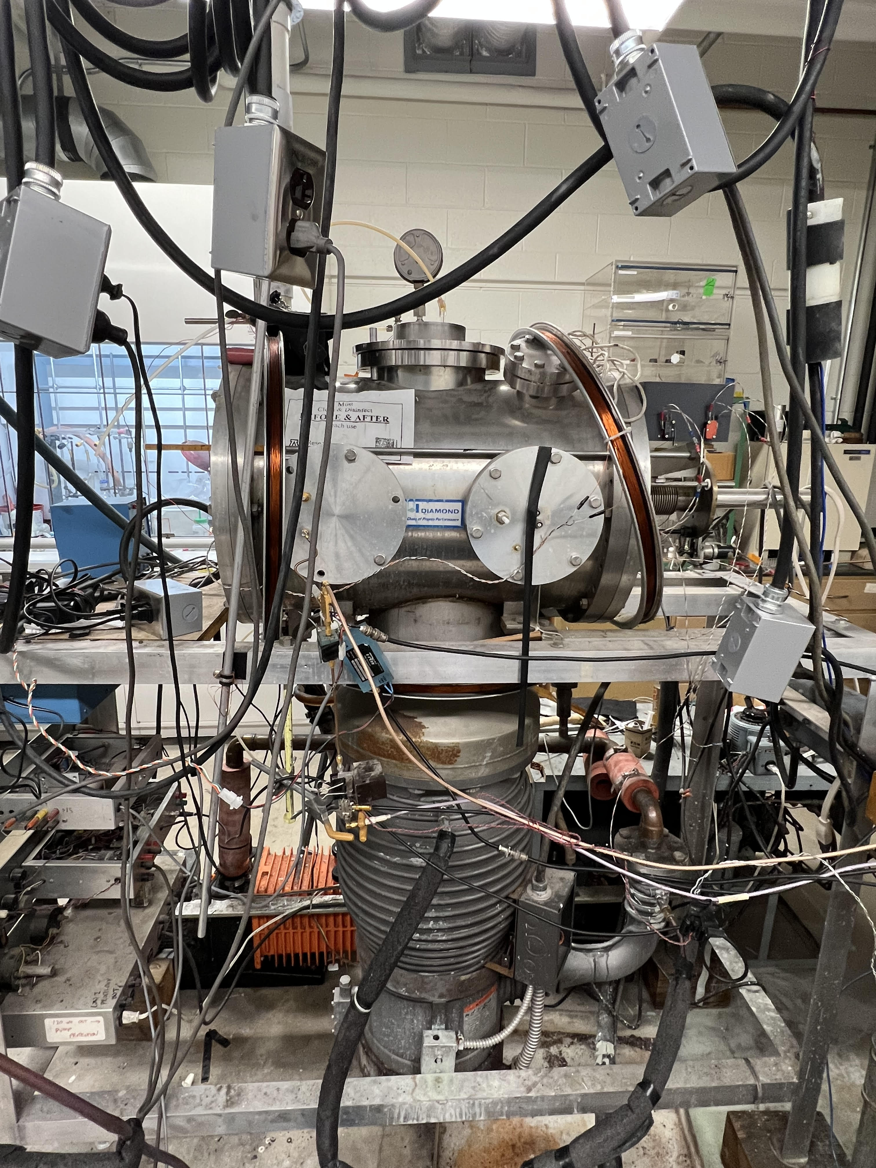
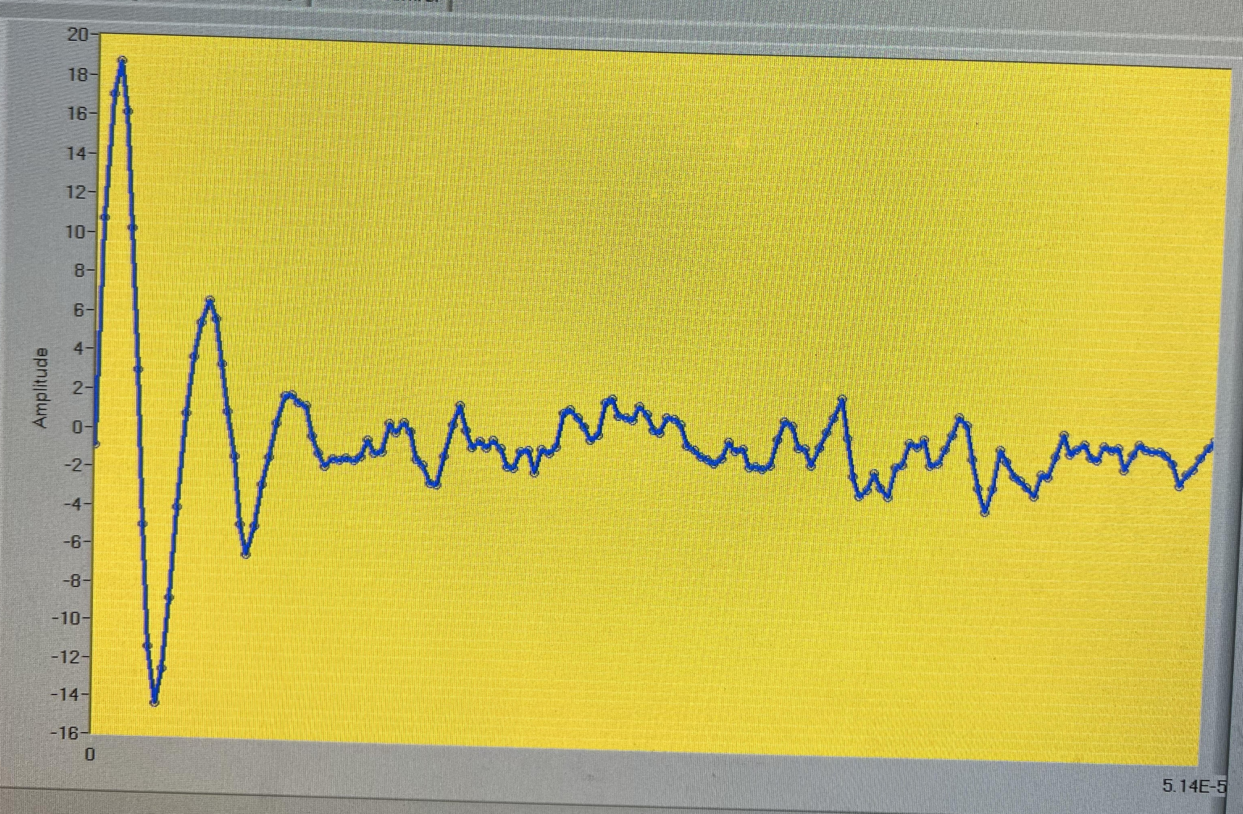
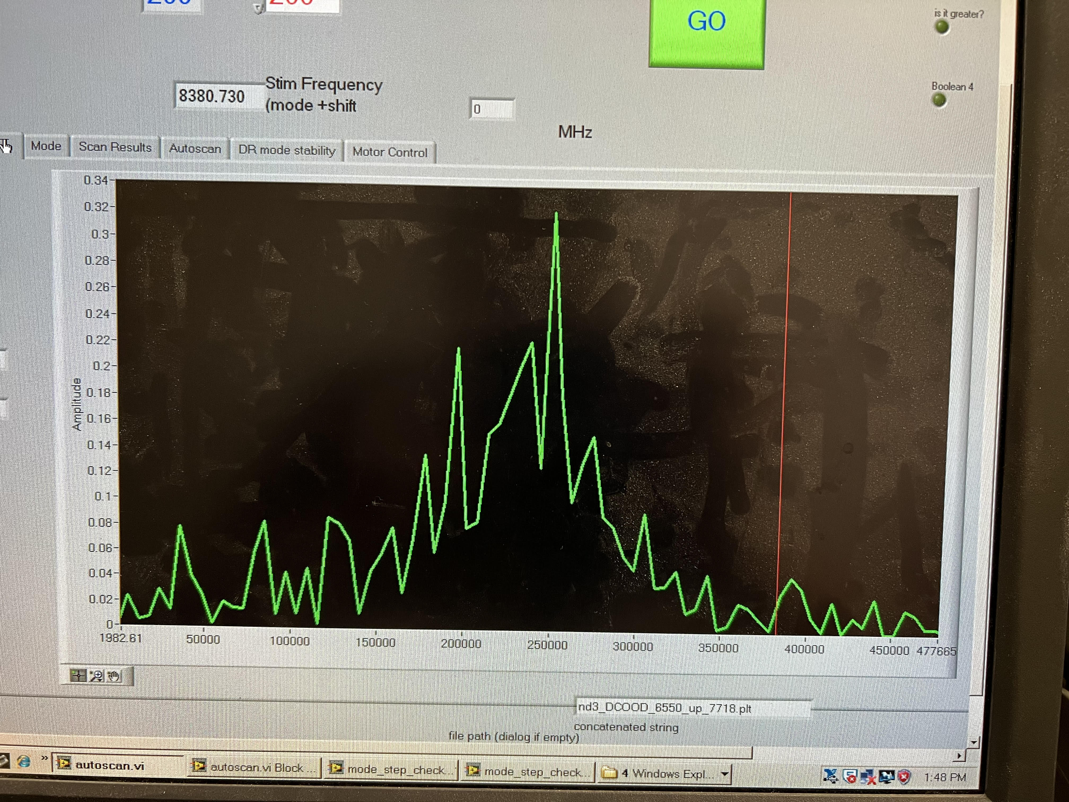
Microwave Spectrometer:
Time Domain
Frequency Domain

Slide 6
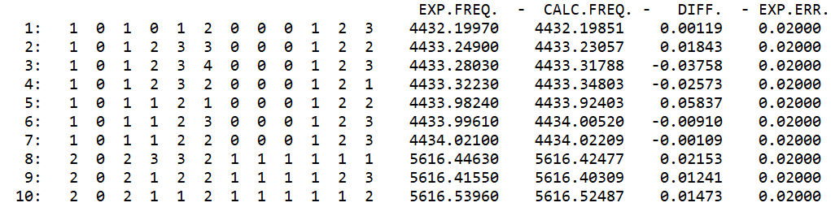
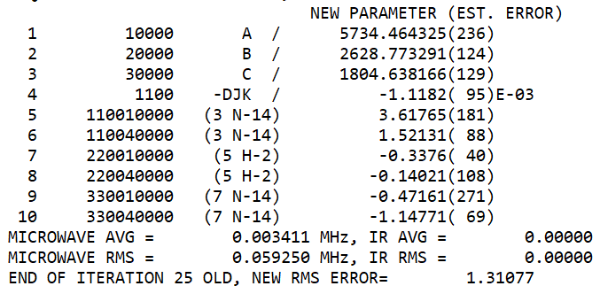
Data Analysis
Use data analysis program called SPFIT
Fits experimental data to a proposed model
Produces values of rotational constants that are compared to predictions

Slide 7
Results
68 total rotational transitions measured in the region of 4.4 – 7.5 GHz
Rotational parameters (A, B, C, and quadrupole coupling constants) have been determined
  DD – isotopologue still in progress
Notes:
Order the bullet points

Slide 8
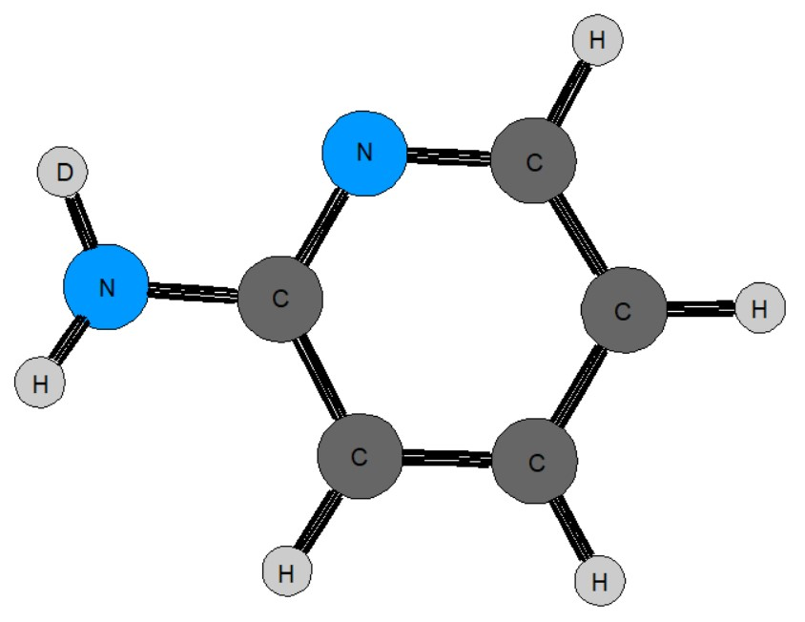
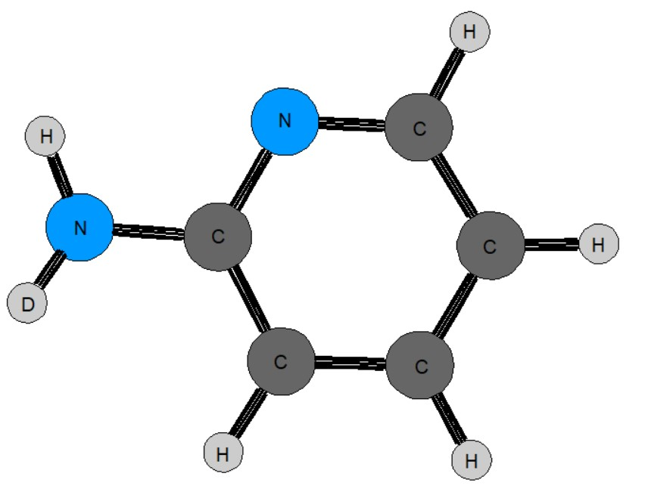
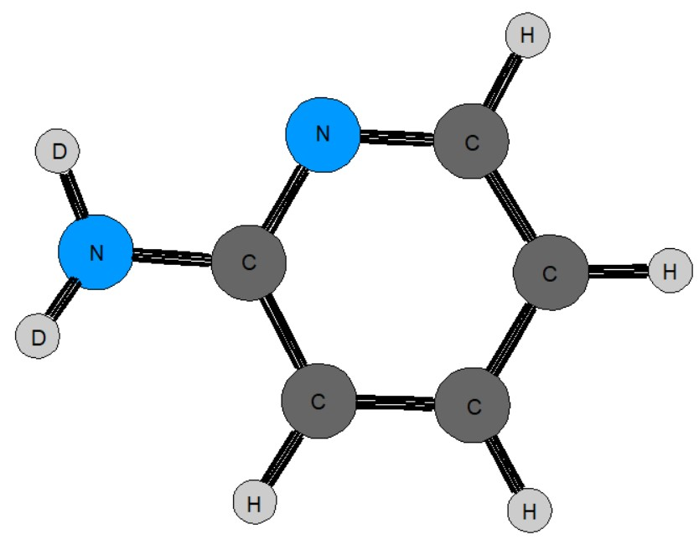
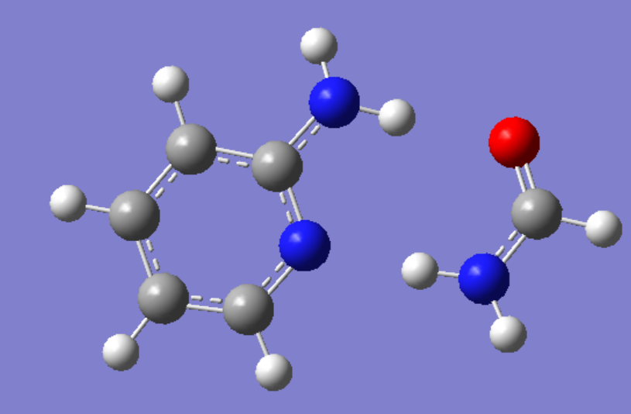
Conclusions
Lowest energy structure of 3 deuterated isotopologues determined
Quadrupole coupling constants determined for ¹⁴N and ²H (deuterium)
Closest model to experimental data: MP2/aug-cc-pVTZ
Future work:
  Further scanning for fully deuterated molecule
  New complexes with 2-aminopyridine
Notes:
Different Quadrupole Coupling Constants means non-equivalent hydrogens

Slide 9
Acknowledgements
Special thanks to my mentors, Dr. Stephen Kukolich and Dr. Adam Daly
Dr. Zunwu Zhou for initial measurements on this project
Arizona NASA Space Grant Consortium
University of Arizona Department of Chemistry and Biochemistry

Slide 10
Thank You

